Slide 1
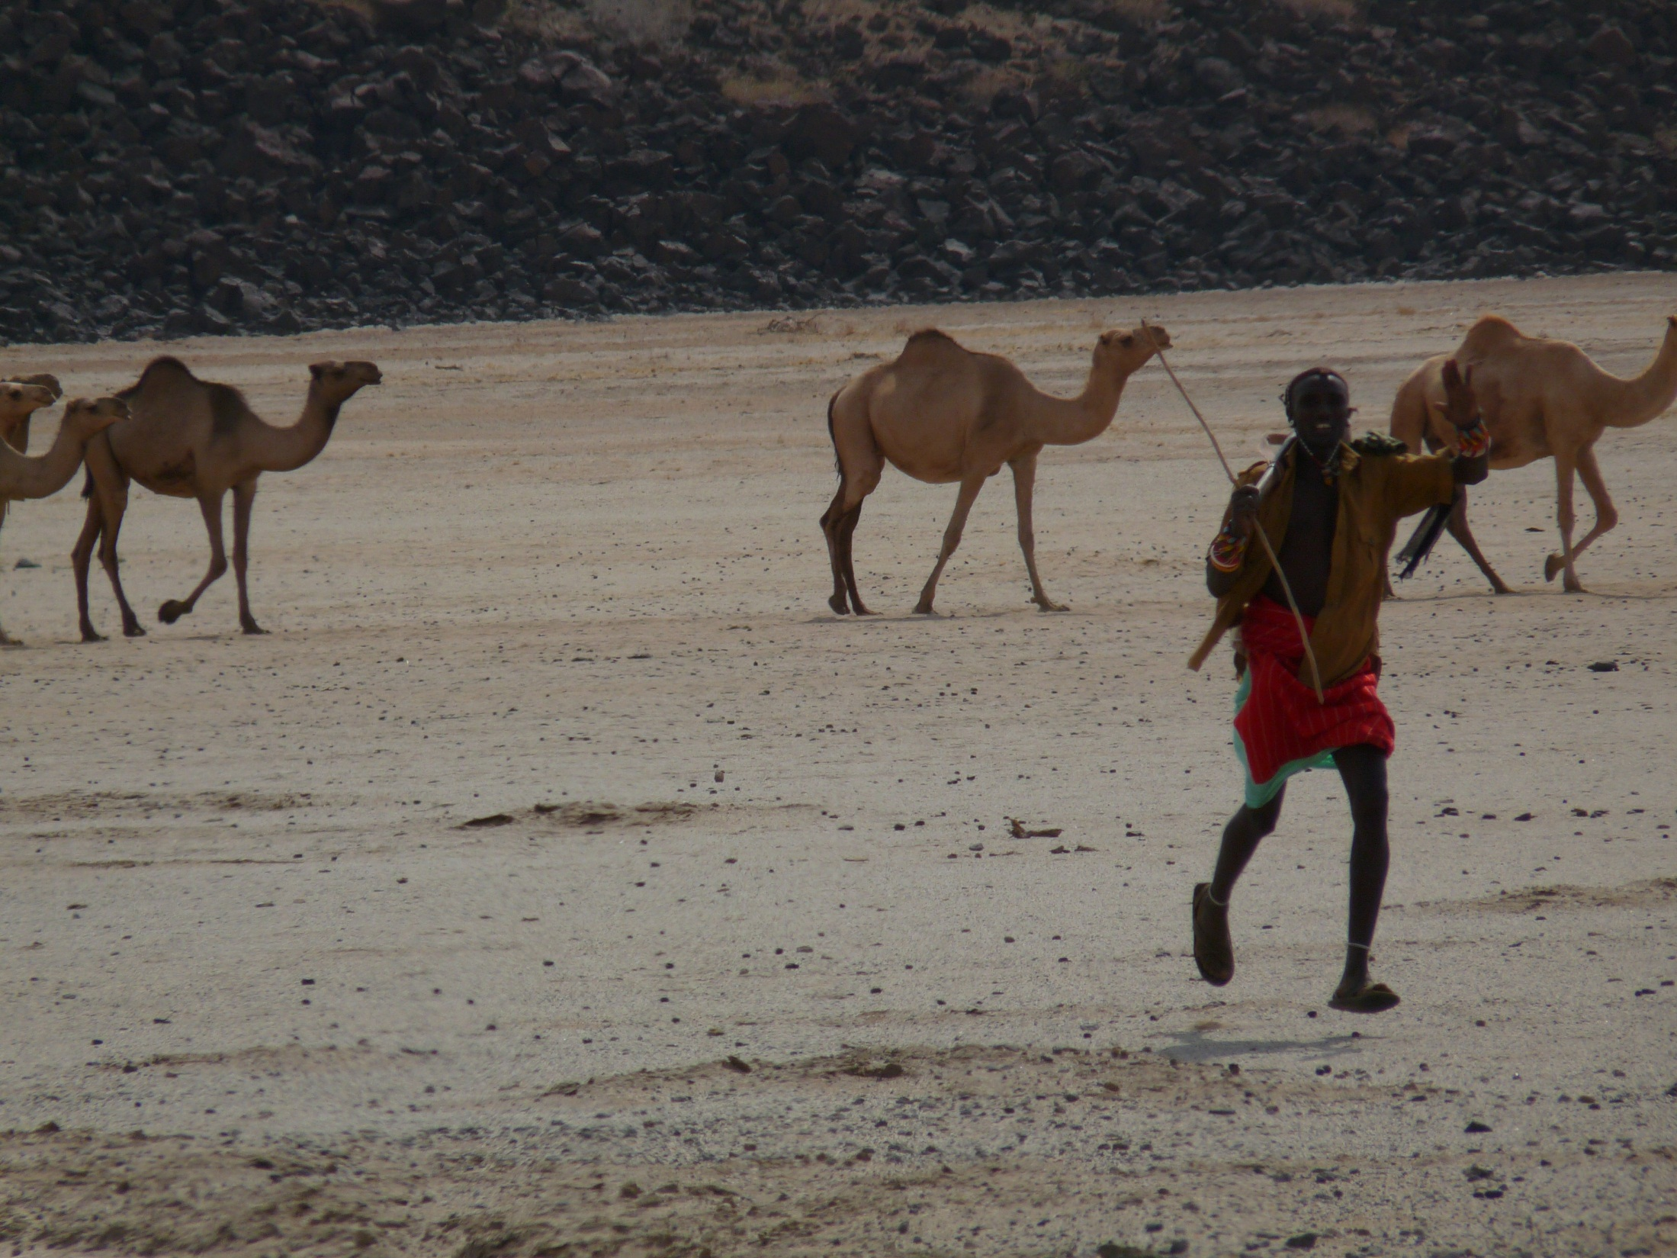

On Risk and Poverty Traps
Chris Barrett, Cornell University
Symposium in Honor of Michael Carter
UC-Davis
June 20, 2026

Slide 2

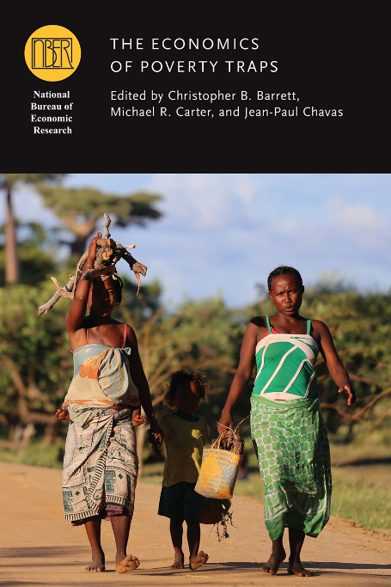
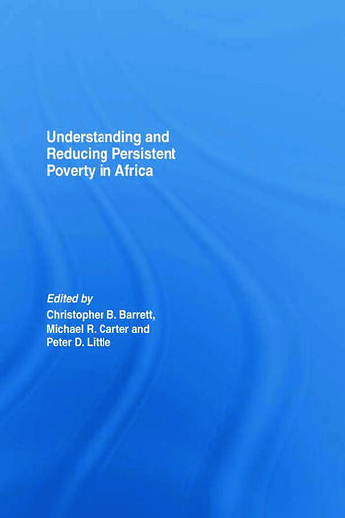
Risk-based poverty traps
The poorest places are defined not only by the depth and prevalence of poverty but equally by poverty’s persistence. A poverty trap?
Michael’s path-breaking work emphasizes the central role of uninsured risk exposure in understanding and addressing poverty traps.
The possibility of risk-based poverty traps puts a premium on risk reduction and risk transfer tools: credit, insurance, savings, novel technologies, social solidarity networks, etc. Helps explain the limited long-term gains of cash transfers.

Slide 3
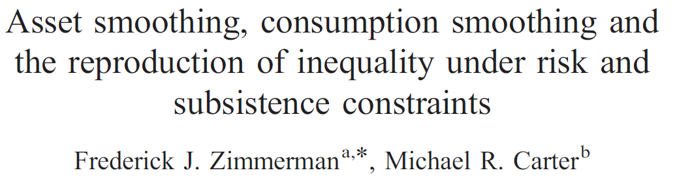
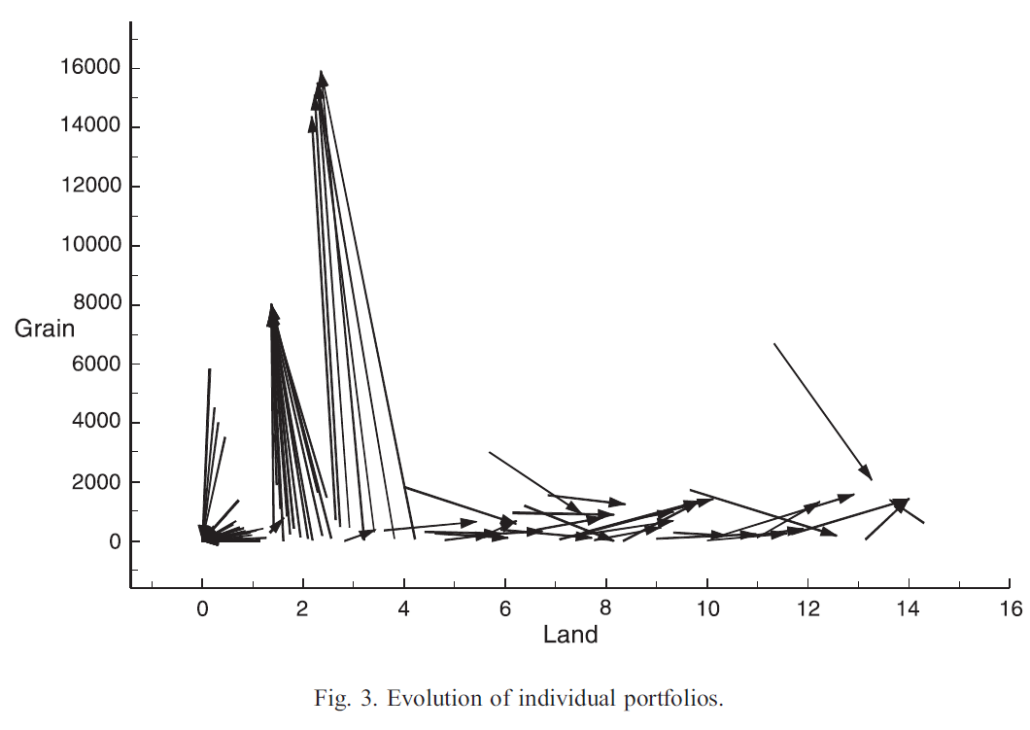
Michael’s seminal work
Michael’s work established early on that Friedman-ite consumption smoothing fails when stochastic income becomes endogenous to productive asset holdings and markets are incomplete or imperfect.

Slide 4

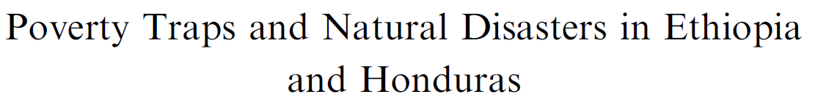
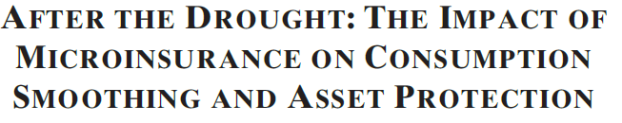
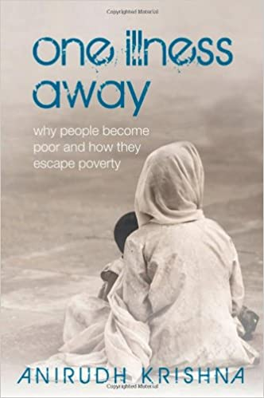
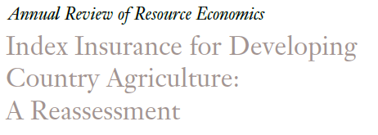
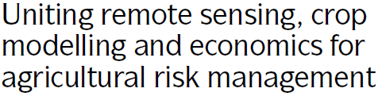
Michael’s seminal work
Michael’s insights helped reignite a flourishing literature on poverty traps, index insurance, etc. and inspired many others.

Slide 5
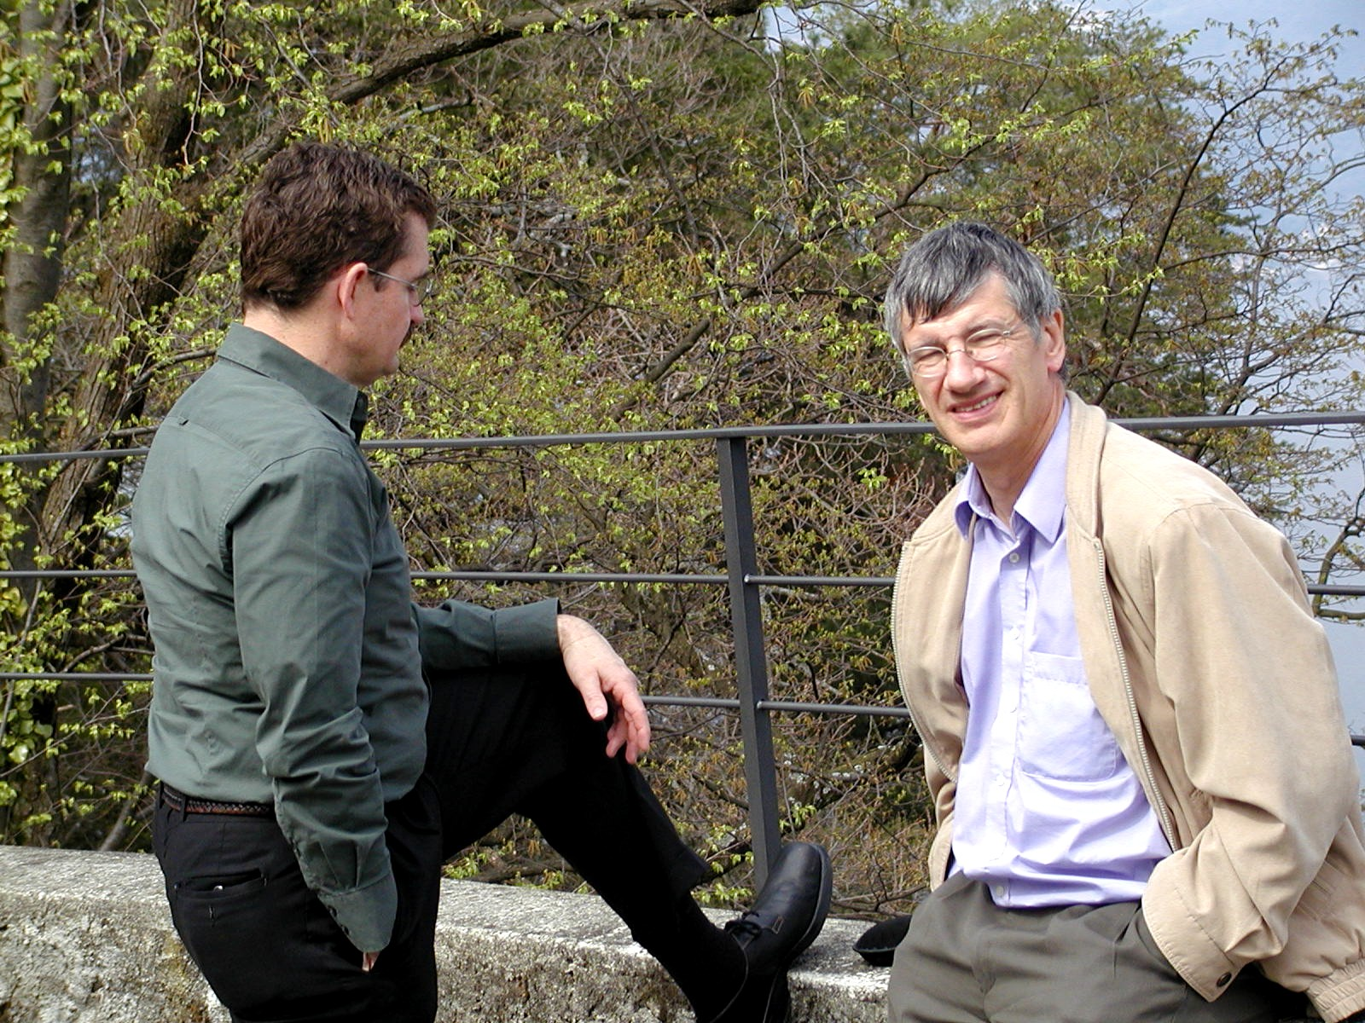

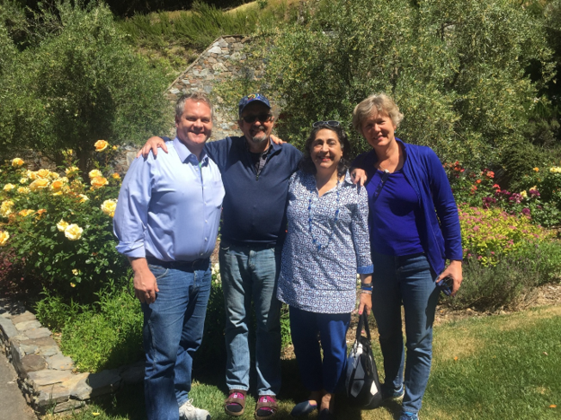
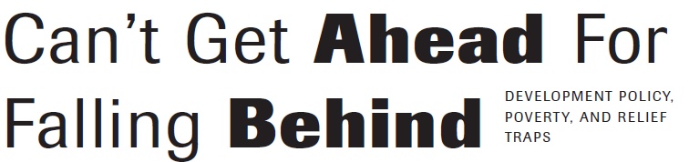
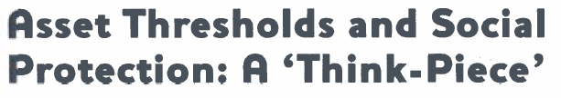


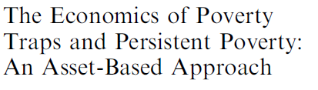
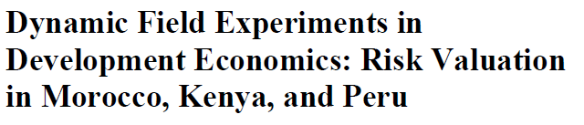



Michael shaped my career

Slide 6
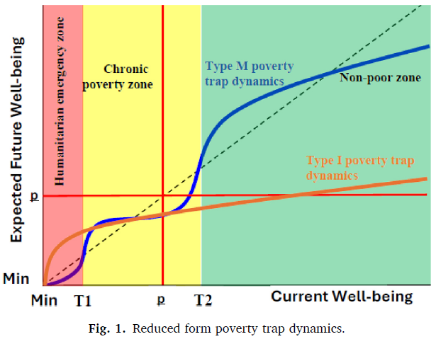
Risk-based poverty traps
A population is a mixture distribution of well-being dynamics. The poor sub population is a mixture distribution of the inescapably and the unnecessarily poor. Risk salient for all, especially the latter.

Slide 7
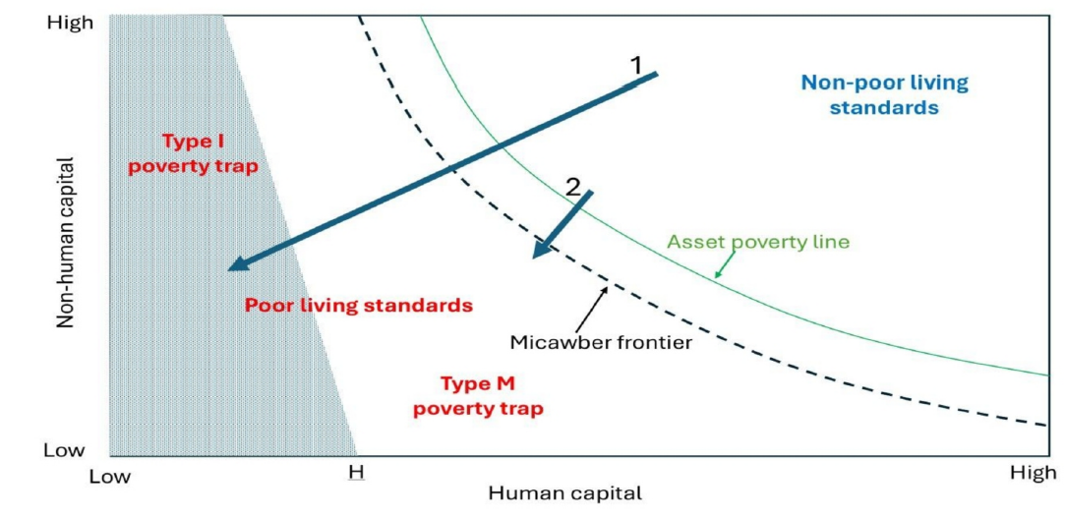
Risk-based poverty traps
Various mechanisms underpin poverty traps: (1) market imperfections, esp. in financial and land markets, due both to the impact of shocks and ex ante risk response; (2) behavioral phenomena, related to cognition, mental health, social solidarity, etc.

Slide 8
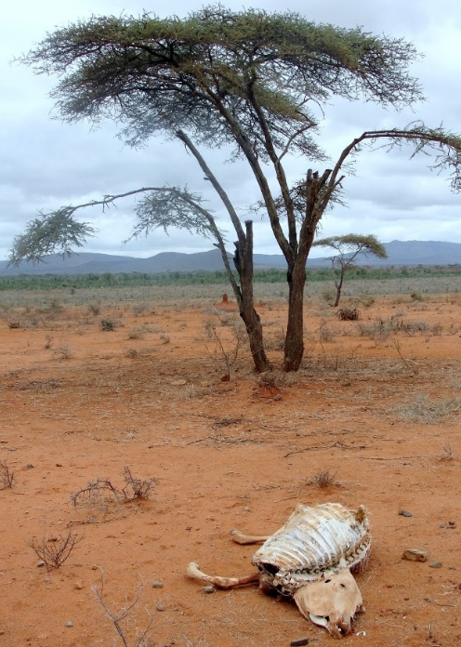
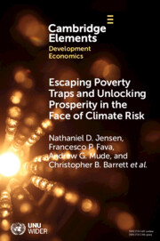
Risk transfer among east African pastoralists
Poverty traps in Kenya/Ethiopia rangelands due to catastrophic herd loss risk from major droughts.
So we designed and launched index-based livestock insurance (IBLI) in 2010. Early use of satellite remote sensing to price risk to leverage reinsurance industry to transfer African drought risk into global capital markets.
Very favorable impacts across multiple metrics and time scales (immediate to 10-year), with policy impacts across Africa. Now in 4 countries, >5 mn insured pastoralists, plus gov’t sovereign risk.

Slide 9
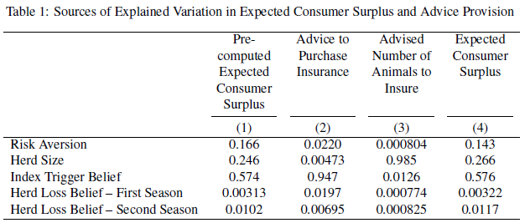
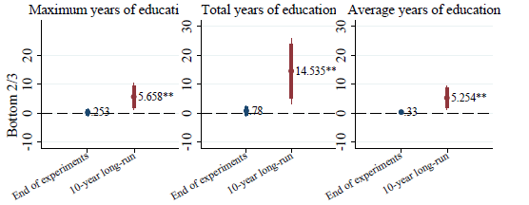
Risk transfer among east African pastoralists
STILL working on refinements to and evaluations of IBLI. In Ethiopia, ~85% would benefit from IBLI uptake, only 8% buy. Tailored advice + pro-consumer agent incentives reduces by 12%! Reveals problem of agent over-selling to low-comprehension buyers.
10-year follow up. Clear herd size bifurcation of behaviors/impacts.

Slide 10
Infectious disease risk reduction in west Africa
Schistosomiasis/bilharzia affects >240mn globally (>800 mn at risk) in poor areas. Suppresses immunoresponse. Especially harmful for children/women.
Usual response: MDA (praziquantel) but high reinfection rates. Must tackle the environmental reservoir of the disease.
Poverty-disease trap: Impedes child cognitive/physical dev’t via anemia, morbidity. Disrupts work/school attendance, lowers incomes, increasing reliance on contaminated water sources.

Slide 11
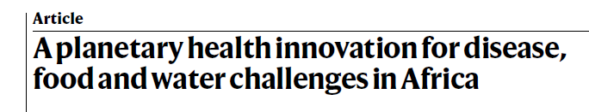
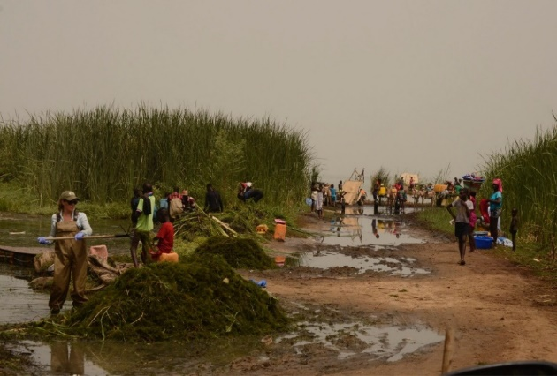
Infectious disease risk reduction in west Africa
Multi-pronged approach:
(1) Clear water access points of snails’ preferred habitat, the invasive, submerged weed Cerato. Demersum. Make compost (B/C: 2.8 - 7.1) or low cost livestock feed.
2024 Frontiers Plant Prize global champion!
(2) Introduce fish to irrigated rice fields to compete with (tilapia) or prey on (African bonytongue) snails and boost crop productivity.
(3) About to start stage 3 livestock vaccine trials. Cattle and human forms hybridized(!) and migrating cattle contaminate water points and irrigated fields.

Slide 12
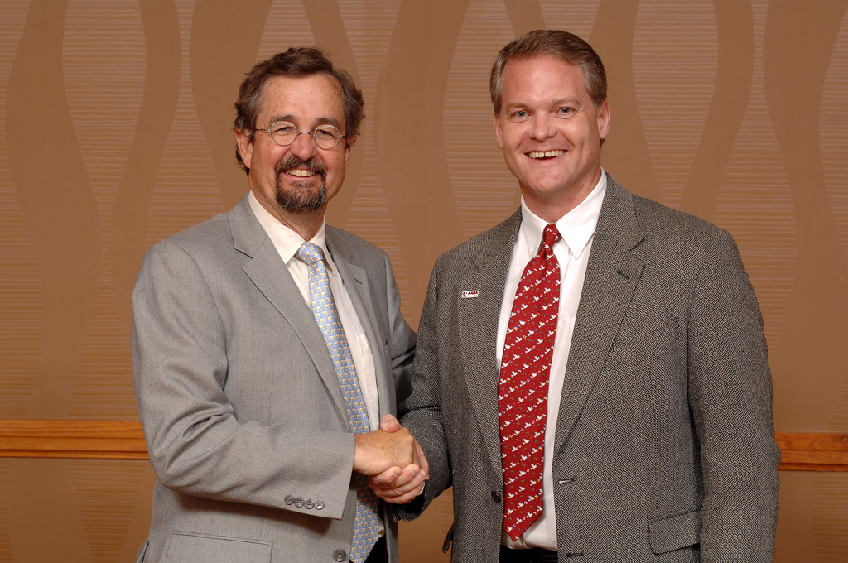
Thank you, Michael, for being a fabulous mentor, collaborator, and person!
Notes:
12

